Slide 1
Adaptive Supply Chains: Demand Sensing

Slide 2


Slide 3


Slide 4
Crystal Ball gazing: A Brief History
But is this good enough?
CAUSAL METHODS :
Econometric methods, Product Lifecycles
TIME SERIES ANALYSIS:
Incorporate Seasonality, Long-term trends
NAÏVE FORECASTING:
Assume last period (year/month) demand will recur
Accuracy
INTUITION:
The Artisanal mindset
Time

Slide 5
Why do most organizations hit a ‘Forecast Ceiling’?
Unexpected events create shocks that have a ripple effect
Demand: weather, customer behavior gone ‘viral’
Supply: Manufacturer/Logistics networks gone awry
Product Assortments
Demand patterns at a SKU level differ from aggregate patterns
SKUs within a category are at different stages in the Lifecycle
Customer behavior is increasingly fickle
Increasing diversity within markets
Engaging customers across channels becoming harder

Slide 6
Can we break the Forecast Ceiling?
DEMAND SENSING:
Near Real-time Feedback loops
CAUSAL METHODS :
Econometric methods, Product Lifecycles
TIME SERIES ANALYSIS:
Incorporate Seasonality, Long-term trends
NAÏVE FORECASTING:
Assume last period (year/month) demand will recur
MAKE TO ORDER: The Artisanal mindset

Slide 7
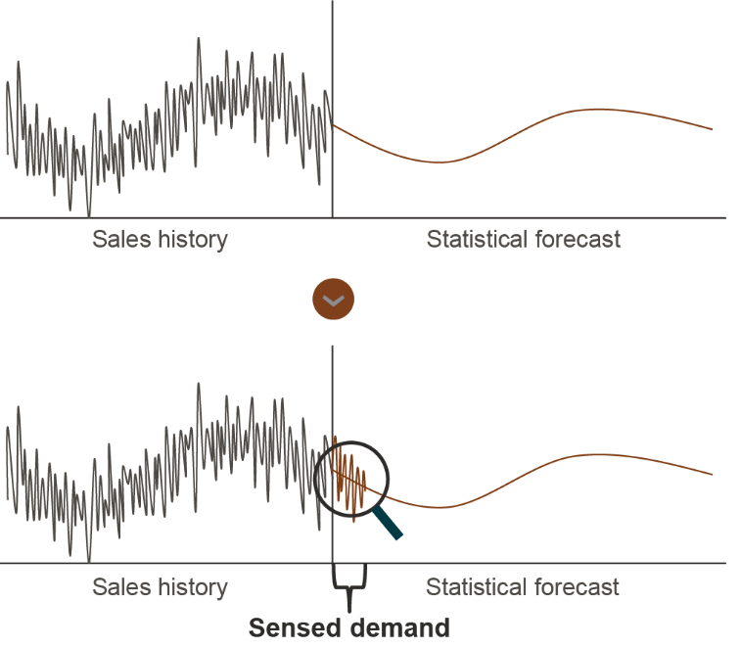
Demand Sensing – How is it different?
Learn from ‘near’ real-time signals
‘Downstream’ data: Social media, customer returns, Contact Center data
Higher level of granularity
Tuning of forecasts at a Day/SKU/Store level based on feedback loops
Leveraging advanced Machine Learning Algorithms
Multi-Tier Causal models to forecast at each level in the Supply Chain
Daily automated publishes
Focus on Anomaly Detection, What-if scenario modeling

Slide 8
Why now?
Data, Data Everywhere
Social Media Listening
In-store tracking
Contact Center Data
Better mousetraps
AI and ML enables use of Structured and Unstructured Data
Hierarchical Forecasting methods
Computing Power
High Performance Computing
Edge Computing
Intelligent Systems

Slide 9
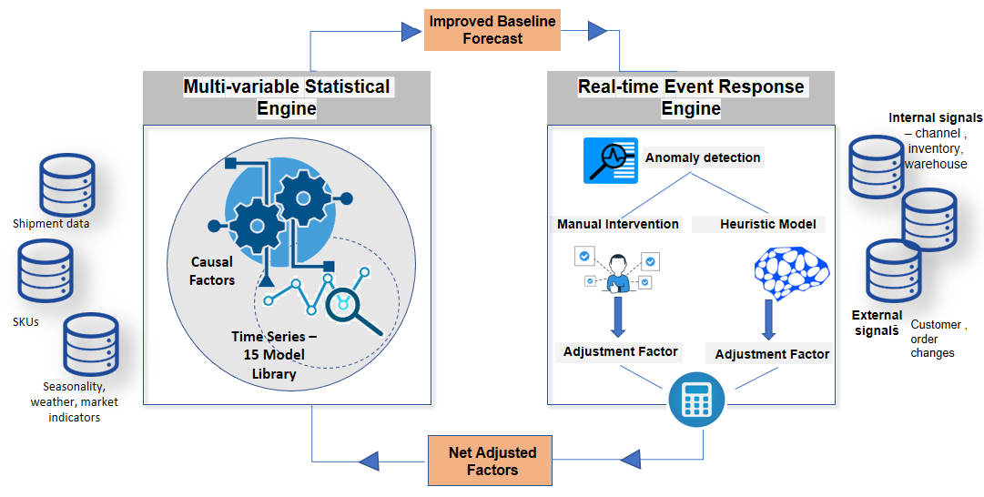
How to make it happen?
Capture real-time signals upstream and downstream
Improve the Baseline Forecasting Solutions
Build a Real-time Event Response Engine
Use the Feedback Loop to refine Forecasts

Slide 10



Adopt a Transformation Journey mindset
Integrated Demand Sensing System
Enhanced Statistical Demand Management
Outcomes:
Business
A robust streamlined Demand Planning process
Huge uplift in short term Forecast Accuracy
Scalable and easily consumable solution
Data
Standardized granular data repository
Causal factors like Customer data, inventory, sell out data ,etc to be part of models
Advancement in Math
More sophisticated ML Frameworks
Collaborative Model
Insights + Anomalies integrated into the Decision Process
Basic Demand Management
Outcomes:
Improved Forecast Accuracy
Higher collaboration
Higher portfolio stability
Process Maturity
Outcomes:
Low forecast accuracy
Large amount of backorders owing to consistent lower accuracy
Existing Gaps :
The volatility and intermittence in demand cannot be accommodated
Simple Time-series methods do not capture the complexity in business
Existing gaps:
Incorporate uncertainties of the future to push FA beyond a ceiling
Time

Slide 11
In summary, to make this happen you need to
Work with an Outcome mindset
Aggregate forecasts no longer good enough: Continuous Improvement program to improve granular forecasts
Be ready to Think from First Principles
Adopt a Portfolio approach: Store/SKU universe into behavioral segments. Don’t fall prey to a simplistic one-size fits all solution
Adopt a Solution mindset
Think Scale and Re-usability: Develop building blocks that can be assembled to create solution by Segment
Invest in Data Capture
Information is power: Capture signals from multiple downstream sources at scale

